Slide 1
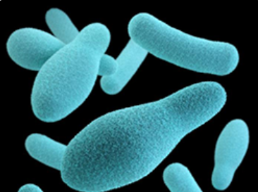
A look at Botulism in the US
Luke Farson
Biostatistics Final Project
November 09, 2020

Slide 2

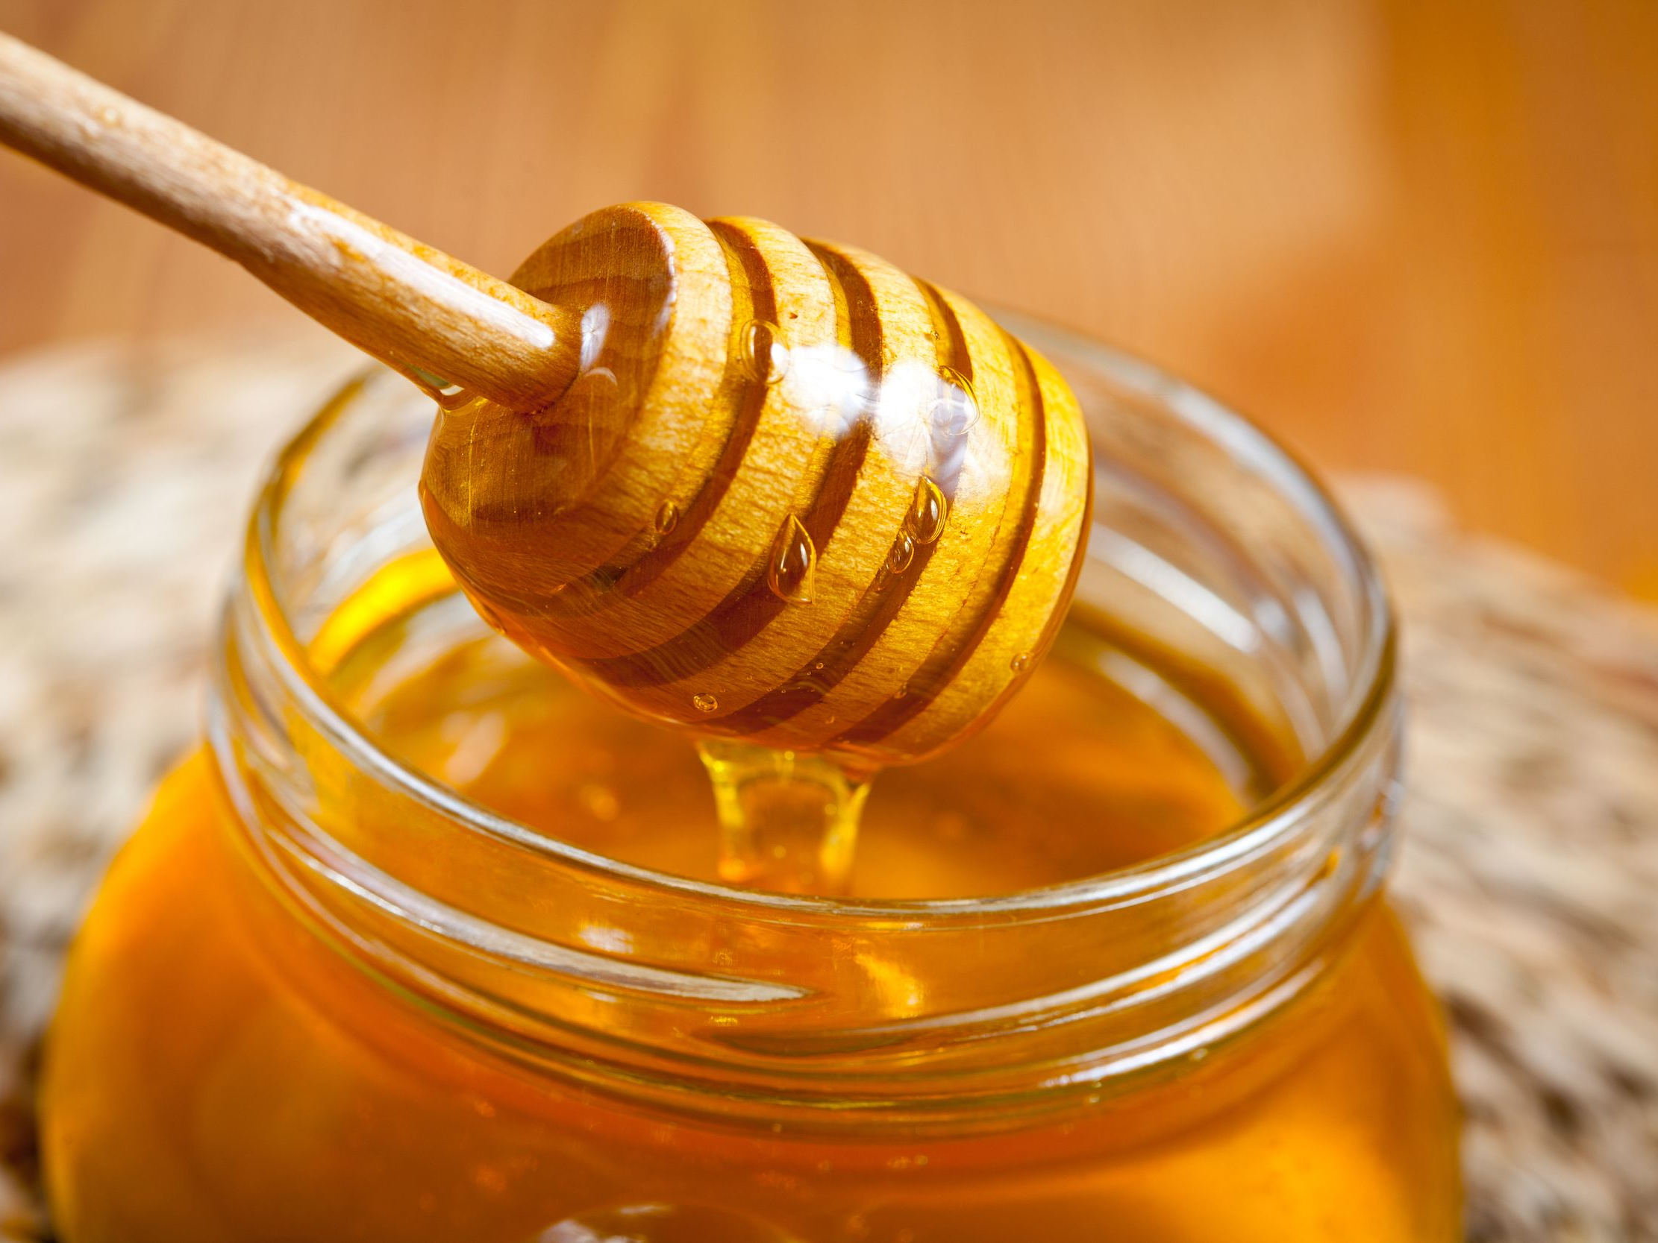
Botox
Clostridium botulinum in the right environment
Foodborne, infant, wound, other
Toxins A-G, only A, B, E, F cause human botulism
Botulism, WHO 2018 https://www.who.int/news-room/fact-sheets/detail/botulism
Notes:
Clostridium botulinum

Slide 3
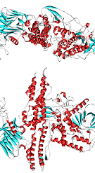
A look at botulism cases in the US from 1899 to 2017 by studying 2280 data points

Slide 4
Hypotheses
Number of botulism cases positively correlates with year and the method of botulism transmission is related to toxin type.

Slide 5
Descriptive Statistics from Three States
California |  |  | Texas |  |  | Ohio
Mean | 7.593567 |  | Mean | 2.358491 |  | Mean | 2.449275
Standard Error | 0.429792 |  | Standard Error | 0.233027 |  | Standard Error | 0.412164
Median | 4 |  | Median | 2 |  | Median | 1
Mode | 1 |  | Mode | 1 |  | Mode | 1
Standard Deviation | 7.948239 |  | Standard Deviation | 2.399161 |  | Standard Deviation | 3.42369
Sample Variance | 63.1745 |  | Sample Variance | 5.755975 |  | Sample Variance | 11.72165
Kurtosis | 1.280868 |  | Kurtosis | 21.89194 |  | Kurtosis | 39.77059
Skewness | 1.35004 |  | Skewness | 4.142386 |  | Skewness | 5.744681
Range | 39 |  | Range | 16 |  | Range | 26
Minimum | 1 |  | Minimum | 1 |  | Minimum | 1
Maximum | 40 |  | Maximum | 17 |  | Maximum | 27
Sum | 2597 |  | Sum | 250 |  | Sum | 169
Count | 342 |  | Count | 106 |  | Count | 69

Slide 7
Botulism cases in the US 1899-2017

Slide 8
Correlation Statistics
Pearson | 0.814608
R_{crit} (df 100) | 0.197

Slide 9
Regression Statistics
Multiple R | 0.814607505
R Square | 0.663585386
Adjusted R Square | 0.660499014
Standard Error | 18.91424977
Observations | 111

Slide 11
Notes:
Paper says type E does better with trypsin.
Infant botulism Ided in 1976 (https://www.emergency.cdc.gov/agent/botulism/clinicians/epidemiology.asp)
https://jamanetwork.com/journals/jama/article-abstract/1162106

Slide 12
X² Results and Conclusions
Χ² for botulism transition type and toxin=299.52
Crit Val from Havel et al for 5 df=11.05; p<0.05
Botulism toxin does have a relationship with botulism transition type
Have caution when preparing food in low O₂ environment
Botulism has greatest prevalence in California
Number of botulism poisonings is increasing
Notes:
https://www.foodsafetynews.com/2017/06/cdc-report-shows-foodborne-botulism-poisoning-increasing/
https://www.emergency.cdc.gov/agent/botulism/clinicians/epidemiology.asp--1980s-90s increase in CA due to drugs, especially black tar heroine

Slide 13
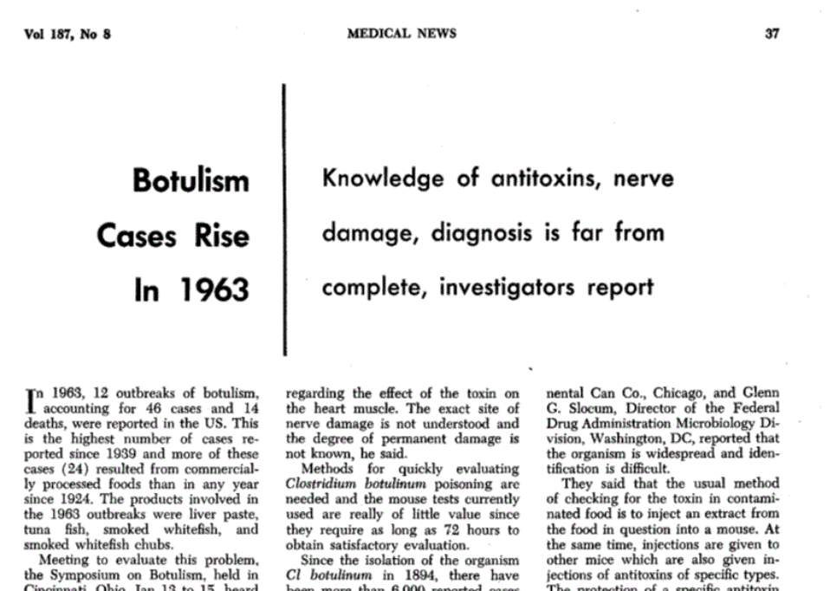
Botulism Cases Rise In 1963: Knowledge of antitoxins, nerve damage, diagnosis is far from complete, investigators report. JAMA. 1964;187(8):37–38. doi:10.1001/jama.1964.03060210097046
Notes:
Botulism Cases Rise In 1963: Knowledge of antitoxins, nerve damage, diagnosis is far from complete, investigators report. JAMA. 1964;187(8):37–38. doi:10.1001/jama.1964.03060210097046

Slide 14
Notes:
Paper says type E does better with trypsin.
Infant botulism ID'ed in 1976 (https://www.emergency.cdc.gov/agent/botulism/clinicians/epidemiology.asp)
https://jamanetwork.com/journals/jama/article-abstract/1162106

Slide 15
Correlation Statistics
Pearson | 0.814608
R_{crit} (df 100) | 0.197

Slide 16
Thank you!
Links to information, dataset, and articles mentioned in this presentation (by order of appearance)
https://www.who.int/news-room/fact-sheets/detail/botulism
Data set: https://data.cdc.gov/Foodborne-Waterborne-and-Related-Diseases/Botulism/66i6-hisz
https://jamanetwork.com/journals/jama/article-abstract/1162106
https://www.foodsafetynews.com/2017/06/cdc-report-shows-foodborne-botulism-poisoning-increasing/
https://www.emergency.cdc.gov/agent/botulism/clinicians/epidemiology.asp

